Slide 1
Autistica Challenge
Team 21

Slide 2
Aim

Slide 3
Challenges for the Client

Slide 4
Demonstration

Slide 5
Benefits and advantages of our solution

Slide 6
Roadmap

Slide 7
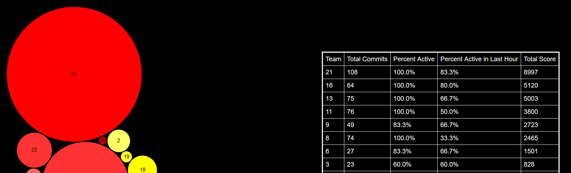
Our Accrediations
21

